Slide 1

IT Capstone Project
Team Members:
Antonio George
Bianca Guimaraes Barros Leal Santos
Jacob Castro
Muhammad Fotih Abdullaev

Slide 2
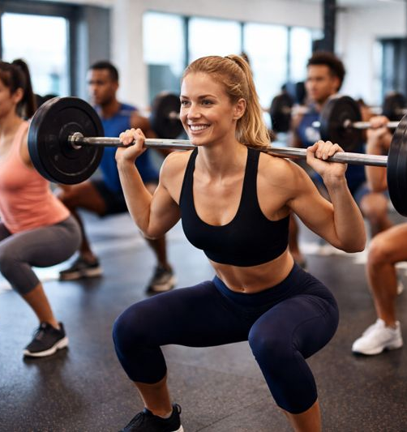
The Business - Uplift Gym
Small local gym
Offers group fitness classes
Limited staff
No online booking system
Class booking is done manually (calls, text, messages)

Slide 3
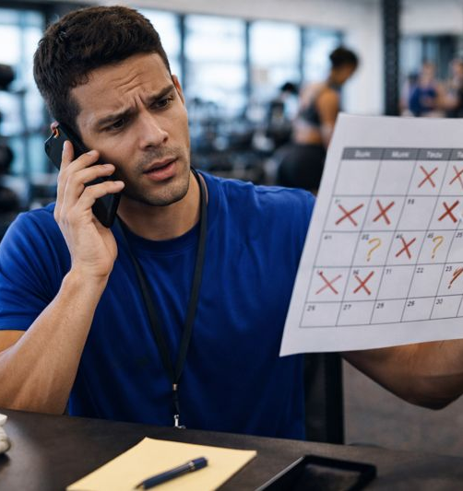
The Problem
Customers must call or message to book classes
Classes can be overbooked
Customers don’t know how many spots are left
Staff repeats the same information every day
Poor organization of class schedules

Slide 4
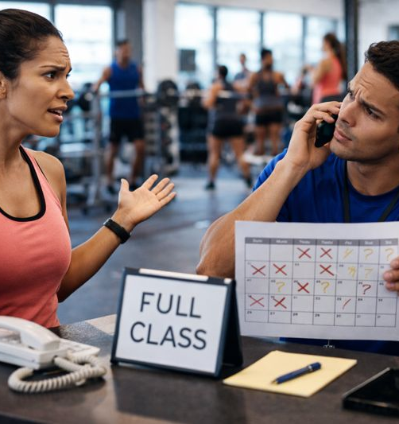
Why This Is a Problem
Wastes staff time
Causes confusion for customers
Creates booking mistakes
Poor customer experience
Limits business growth

Slide 5
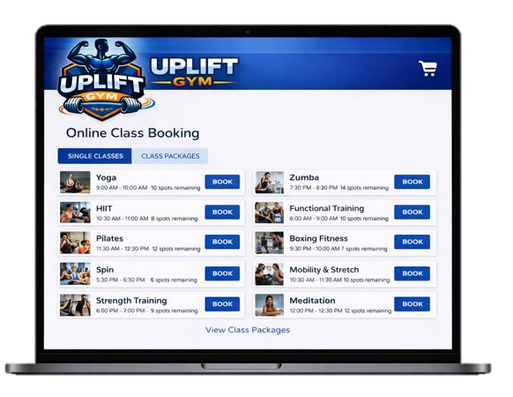
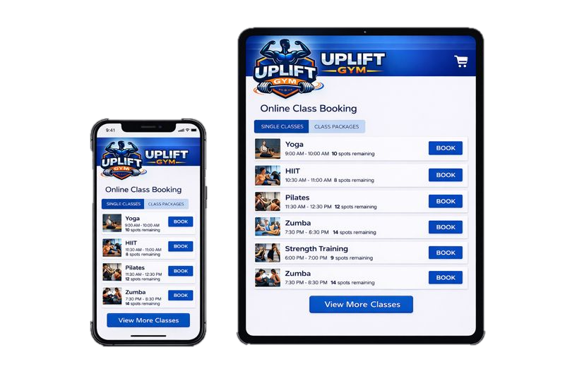
Our Solution
An online class booking website
Customers can:
View available classes
Check schedules
See remaining spots
Book classes online
Buy class packages
This is a visual mockup, not the final implementation

Slide 6
Key Features
🛒 Online Sales
🎟️ Single class purchase
📚 Class packages
🛒 Shopping cart
💳 Simulated checkout
📅 Class Booking
🏋️‍♀️ 10 fitness classes
👥 20-person limit per class
🔄 Real-time availability
⛔ Booking stops when class is full

Slide 7
Design & Technology
💻 HTML, CSS, JavaScript
📱💻 Responsive design (desktop & mobile)
🗄️ Database (Node.js, MySQL) for:
Classes
Schedules
Bookings

Slide 8

Tools Used
GitHub – Version control and collaboration
🌐GitHub Pages – Front-End website hosting
💻Raspberry Pi – Back-End server hosting
⚙️Node.js – back-end application logic
🗄️MySQL – database management
📊Repsona Gantt – project planning and Gantt chart

Slide 9
Team Roles
⚙️💻Back-End Development:
👤Muhammad – Database and booking logic
👤Jacob – Class schedules and data validation
🎨💻Front-End Development:
👤Bianca – Website pages and responsive design
👤Antonio – JavaScript interactions and alerts
All team members support each other as needed

Slide 10
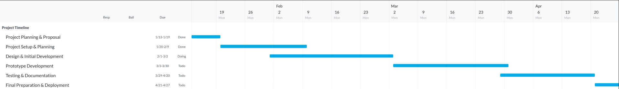
Project Timeline

Slide 11
GitHub Repository
Project repository created
Used for all source code and documentation
Includes proposal and project timeline
Repository is private
Access can be granted to the professor upon request
https://github.com/jcastro72/UpliftGym

Slide 12
Thank you!

